Slide 1
Reimbursement Accounts in 2022

Slide 2
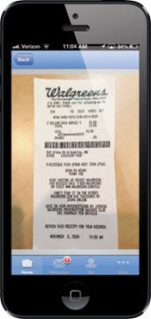
Webinar Agenda:
1. How to maximize pre-tax savings:
Healthcare Reimbursement Accounts
Dependent Care Reimbursement Accounts
Limited Purpose Medical Accounts
FSA Store - An easy way to make purchases!
2. Tools available to help you manage you account:
GDI’s Debit Card and Mobile App
GDI’s Secure Participant Portal

Slide 3
Who Can Participate?
Healthcare Reimbursement Accounts:
All Bates benefit-eligible employees
Healthcare Reimbursement Account dollars can be used for all your tax dependents’ eligible expenses
Healthcare Reimbursement Account dollars can be used for your dependents up to age 26, even if they are not tax dependents. Eligibility ends December 31st of the year in which the dependent becomes 26
Health Savings Accounts:
If you or your spouse plan to contribute to an HSA in 2022, you are not eligible to elect a regular Healthcare Reimbursement Account in 2022. You may elect a Limited Purpose Reimbursement Account.
If you have carryover remaining after the 2021 plan year, you may elect to put your carryover into a Limited Purpose Reimbursement Account.

Slide 4
Employees Love Health Reimbursement Accounts Because They Save Money
These accounts allow you to set dollars aside in pre-tax wages, which means more money in your pocket!
No payroll taxes apply to your contributions
Contributions are easily deducted through payroll.
Elect a maximum of $2,750 ($100 minimum) for you and your family’s predictable, manageable out-of-pocket medical, dental, and vision expenses
Your full annual election is available to use all year
Eligible expenses include deductibles, coinsurance, copays, glasses, contacts, dental expenses, etc.
You can carry over unused balances from 2021 into 2022.

Slide 5
Calculating Your Health Care and Dependent Care Reimbursement Needs
Ask yourself:
What are my predictable expenses for the next year?
Do I need after school care for the kids?
New eyeglasses or dental care?
Review last year’s out-of-pocket medical and childcare expenses to predict 2022 needs
Use the GDI Expense List/Estimator to review eligible expenses and estimate your expenses for the year.

Slide 6
What is a Limited Purpose Medical Account?
A Limited Purpose Account is permitted for use with a Health Savings Account (HSA) and is limited to vision & dental expenses.
A “post-deductible” feature allows you to be reimbursed for general medical expenses after the minimum deductible ($1400 single or $2800 family) is met.
Maximum election $2,750/Minimum $100
If you are thinking about electing an HSA, combining it with a Limited
Purpose Health Reimbursement Account may be right for you. See the
Limited Purpose Account materials for more details.

Slide 7
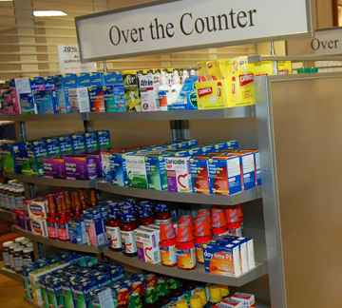
Eligible OTCs
The CARES Act of 2020 allows over-the-counter drugs and medicines to be purchased without a prescription using FSA funds. You now have even more flexibility to save on the cost of health-related products you purchase every day. That's great news for you!
Common Eligible OTC Items you may purchase without a prescription:
Cold, Flu, Pain relief medications
Allergy medication, nasal sprays
Antacid, digestive medications
Menstrual products
Ointments for pain or first aid
First Aid, bandages, cold packs
Smoking cessation products
Reading glasses, eye drops
Certain OTC Items still require a prescription, these include:
Dietary supplements
Herbal supplements
Massage therapy
Special foods
Vitamins

Slide 8
Some Ineligible Medical Expenses
Cosmetic surgery
Teeth whitening
Electrolysis
Hair transplants
Care from non-licensed medical professionals

Slide 9
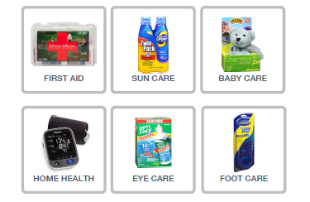

Slide 10
Purchase various over-the-counter items using your GDI Debit Card.
If items require a physician prescription, they are marked as “Rx” and you are prompted to upload the prescription through the web-site.
Easy to use!

Slide 11
Carryover of 2021 Balances into 2022
100% of unused balances in your Healthcare, Limited Purpose Healthcare or your Dependent Care Reimbursement Account may be carried over from 2021 to 2022. Note that this is a special pandemic related option that Bates has adopted. We anticipate that normal rules will resume for the 2023 plan year.
Your carryover amount will be immediately available for 2022 claims as well as remaining available for 2021 claims throughout the 90-day run-out period.
Starting a new HSA in 2021? You may direct your Healthcare carryover funds into a Limited Purpose Reimbursement Account.

Slide 12
Here’s how the Carryover works at Bates!
Bates participants have a $100 minimum annual election.
If your year-end balance is $100 or greater, you may carryover your balance without making a new 2022 election.
If your year-end balance is less than $100 and you do not make a new election for 2022, your carryover will be forfeited.

Slide 13
Dependent Care Reimbursement Account
Set aside pre-tax money from your income to cover eligible day care expenses for children up to their 13th birthday.
Up to $5000 per year for single parents or for married parents filing a joint tax return
Up to $2500 per year for married couples filing separate tax returns
Eligible expenses: Before & after school care, pre-school, day camps, fees paid to a provider in your home or their home
Ineligible expenses: Kindergarten, child support payments, overnight camp, incidental babysitting
Special 2021 legislation allowed a higher maximum which does not continue for 2022!

Slide 14
Tools for Managing
your Accounts

Slide 15
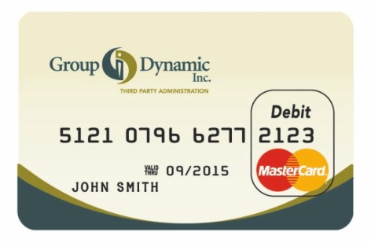
GDI Debit Card
Every participant in a Healthcare or Limited Purpose Healthcare Account has the use of a debit card at no cost. (Two cards issued to each participant.)
Please keep your cards from year-to-year as they have a 5-year life!
If you are new to the Healthcare accounts in 2022 you will be issued a card. If you prefer to file claims via web, mobile app, fax or mail – you may still do so.
If you lose your card or need additional cards, call GDI at 800-626-3539. A $10 fee will be deducted from your balance.

Slide 16
GDI Debit Card – Basic Facts
Access your annual Healthcare Reimbursement or Limited Purpose Healthcare Account dollars at the point of sale. No more paper claims!
Card may be used at any Medical, Vision or Dental provider who accepts MasterCard.
The card does not require a PIN, but you may request one by calling 1-866-898-9795.
Order additional cards – for your spouse and for adult dependent children.
Be sure to save your receipts, in case your card transaction can’t be automatically substantiated. The GDI Mobile App with text alerts is a great tool to manage card transaction substantiation.

Slide 17
Debit Card Substantiation
(IRS Revenue Ruling 2003-43)
Type of Charge On Debit Card | Substantiation Required | No Follow-Up Required
Matched Co-pays | None | ✓
Transactions at pharmacies and grocers that can electronically validate the expenses at the point of sale. | None | ✓
Recurring Expenses | 1 time only | No further substantiation required if subsequent transactions are at the same merchant for the same dollar amount
Dental Care | ✓
Vision Care | ✓
Medical Care | ✓
Type of Charge on Debit Card

Slide 18
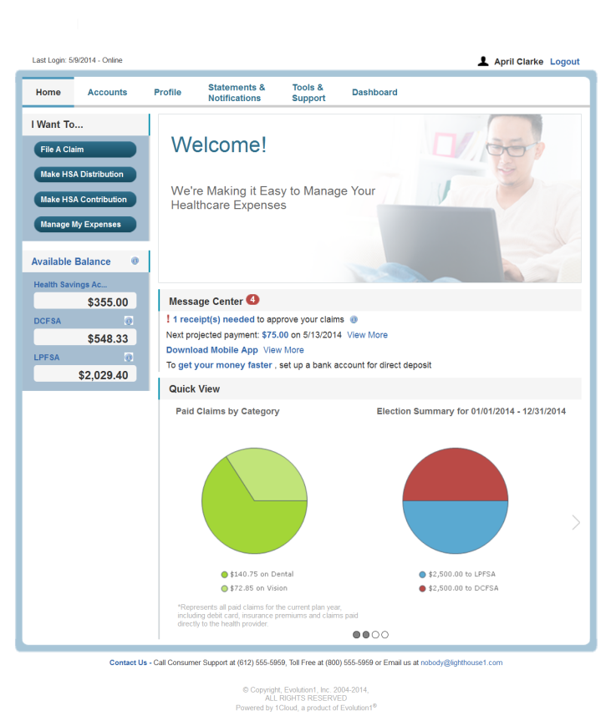
GDI’s Participant Portal: Manage Your Account Online!
File claims online
Sign up for direct deposit
Upload receipts for card substantiation
View real time account balances & account activity
Track claims and reimbursement history
Download plan information & forms
Report lost/stolen cards and request new or additional cards
Update your personal profile information
- Add dependents
- Change your login ID and/or
password
- Elect to get e-mail or TEXT
updates and notifications
Download the GDI Mobile App

Slide 19
GDI’s Mobile App
Easy and On-the-Go!
Download our App from your Home Page in the GDI Participant Portal
Access your accounts from smart phones or tablets
Submit claims
Take and send photos of your receipts
Set text alerts for account updates

Slide 20
Facts & FAQs
Employees

Slide 21
Facts & FAQs - 1
The plan year runs from January 1 through December 31.
The Annual Healthcare Reimbursement Account Maximum is $2,750; Minimum is: $100.
The IRS Dependent Care Maximums are $5,000 for single parents or for married parents filing a joint tax return and $2,500 for married couples filing separately.
At plan year end in 2021 you may carry over up to 100% of unused funds from any Reimbursement Account into 2022.
Run-off: You have 90 days from the end of the plan year (December 31) to submit Healthcare and Dependent Care expenses incurred during the 2021 plan year.
.

Slide 22
Facts & FAQs - 2
Can I change my Healthcare Reimbursement Account elections during the year?
Only if you have a qualifying event:
Birth, death, marriage, divorce, adoption or a change in eligibility because of age or status of a dependent
Gaining responsibility for a dependent’s medical or daycare expense due to court order
You or your spouse gain or lose eligibility for qualified benefits during the plan year
When can I make election changes to my Dependent Care Account?
When you change daycare providers, and when your daycare hours or rates change.
Can I transfer money from a Dependent Care Account to a Healthcare Account?
No. The IRS prohibits this.
Do I need to report these accounts on my taxes?
If you participate in the Dependent Care FSA, you must file IRS Form 2441 with your annual tax return
The IRS does not require any reporting for Healthcare Reimbursement Accounts

Slide 23
Facts & FAQs - 3
What about the IRS Child Care Credit?
Generally speaking, employees with combined family adjusted gross income of $40,000+ save more by participating in a Dependent Care FSA than by taking the tax credit. Obtain a copy of the IRS Form 2441 and review the amount of credit due to you in your income bracket for more information. (See IRS Publication 503) Please note that special legislation applying to tax year 2021 only made changes to the childcare tax credit.
What happens if my employment terminates?
For Healthcare Reimbursement Accounts:
You can submit reimbursements for services incurred up to and including your date of termination.
You have 90 days from your termination date to submit reimbursement requests for services incurred through your last day of work.
Your GDI Debit Card will not work after your employment terminates, but paper claims can be submitted.
In some circumstances, you may be able to elect to continue your account through COBRA.
For Dependent Care Accounts:
Payroll deductions stop with termination; claims can be submitted for dates of service through the end of the plan year. (Run out period limitations to not apply to Dependent Care claims.)

Slide 24
Facts & FAQs - 4
How will I be notified if a receipt is required for a GDI Debit Card transaction?
GDI will email you and post an online notification IF you provide us with your email address or your text number at the consumer portal.
Otherwise, notices will be mailed to you and the requested receipt can be returned through the GDI Participant Portal, by email, fax, or through the mail.
I received a letter, but lost the receipt(s), what do I do?
If you are unable to obtain an itemized receipt or statement from the provider or vendor, you may send in a paper claim with documentation for other eligible expenses that you paid for out of pocket. The amount of the documentation must equal or exceed the amount requested in the letter. In cases when we do not receive the receipts requested or repayment for the claims in question within 30 days, your card will be temporarily deactivated.
How do I get my card reactivated?
Either submit the documentation requested; submit a paper claim with documentation for eligible expenses paid for out of pocket; or send a check to GDI for the total amount requested.

Slide 25
Thank you for your time!

