Slide 1
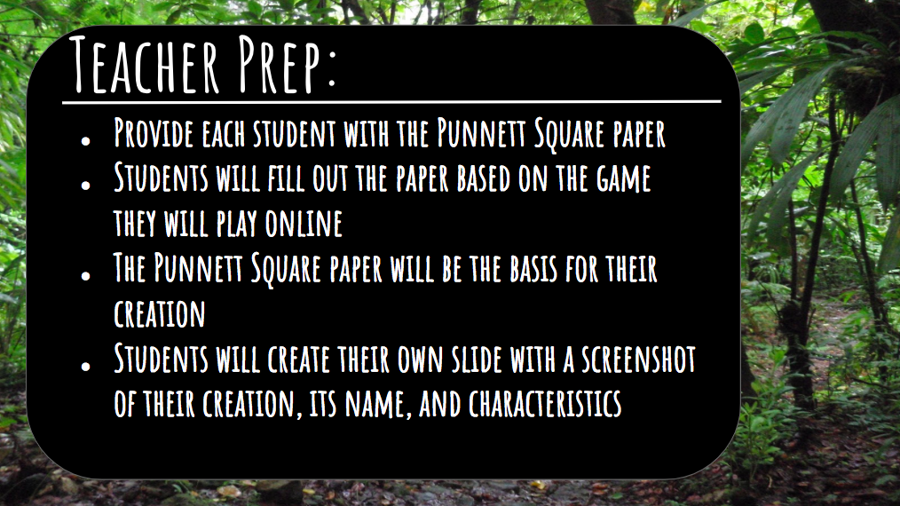
Notes:
Before you show this to students, delete the teacher slide.

Slide 2


Slide 3
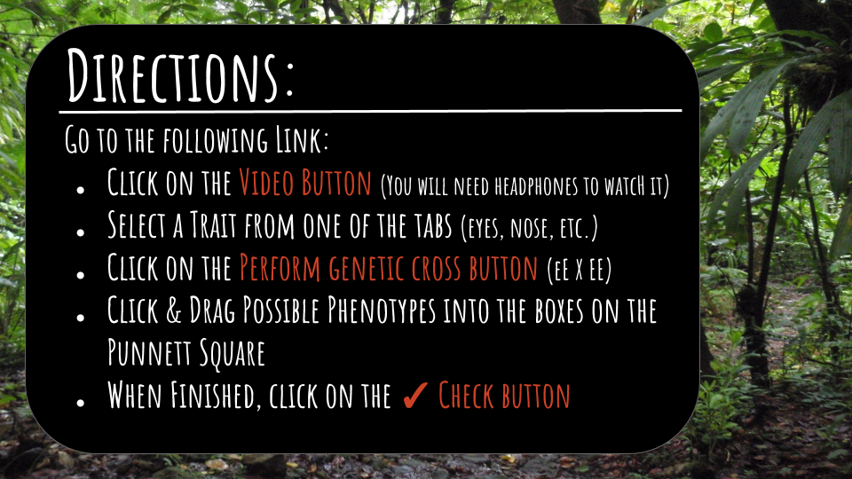
https://bit.ly/1hBPdTM

Slide 4
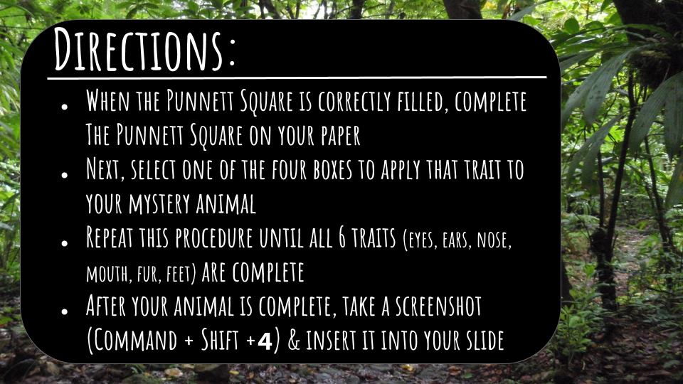

Slide 5
Student Table of Contents
Student 1 | Student 2 | Student 3 | Student 4 | Student 5
Student 6 | Student 7 | Student 8 | Student 9 | Student 10
Student 11 | Student 12 | Student 13 | Student 14 | Student 15
Student 16 | Student 17 | Student 18 | Student 19 | DeBlois Example

Slide 6
Student 1

Slide 7
Student 2

Slide 8
Student 3

Slide 9
Student 4

Slide 10
Student 5

Slide 11
Student 6

Slide 12
Student 7

Slide 13
Student 8

Slide 14
Student 9

Slide 15
Student 10

Slide 16
Student 11

Slide 17
Student 12

Slide 18
Student 13

Slide 19
Student 14

Slide 20
Student 15

Slide 21
Student 16

Slide 22
Student 17

Slide 23
Student 18

Slide 24
Student 19

Slide 25
